Slide 1
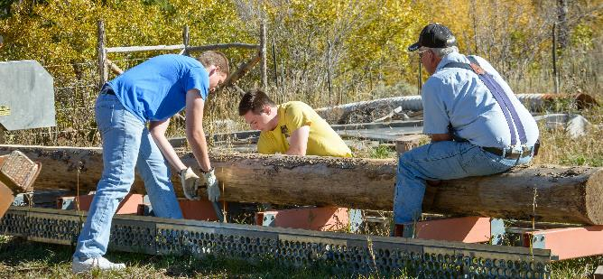
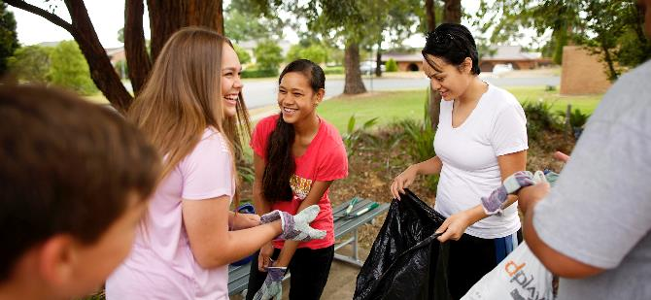
JustServe.org
JustServe is provided as a service by The Church of Jesus Christ of Latter-day Saints. © 2017 by Intellectual Reserve, Inc. All rights reserved. PD60004681
Notes:
1. Time: 20-30 minutes.
2. This presentation may be adapted for an individual (such as the head of an organization), a group of leaders (such as a city or interfaith council), or a civic group (such as a service club or school).
3. Print a handout for each participant. The handout is available on the resource page at the end of the Facilitator Guide.

Slide 2


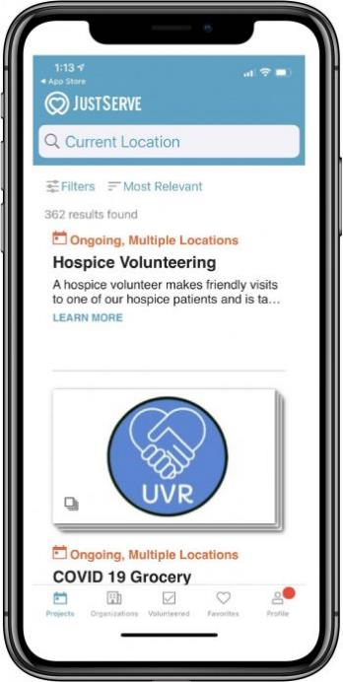
WHAT
FREE community service
Website & Mobile app
POST Opportunities
SEARCH Opportunities
WHO
Community
Non-Profit
Faith
Government
https://youtu.be/_U7Syh6QSJU
JustServe Introduction Video
Notes:
1. Time: 20-30 minutes.
2. This presentation may be adapted for an individual (such as the head of an organization), a group of leaders (such as a city or interfaith council), or a civic group (such as a service club or school).
3. Print a handout for each participant. The handout is available on the resource page at the end of the Facilitator Guide.

Slide 3


How Does JustServe Make My Life Easier?
JustServe.org reduces the time needed to find meaningful service opportunities and allows more time to give service. It helps you get involved in the community and allows you to select service opportunities that are a perfect fit for yourself, your family, or your organization.
Notes:
Share the Community Service/JustServe handout with participants.

Slide 4
What is JustServe?
JustServe is a free community resource.
The JustServe.org Website and APP is used by
faith, nonprofit, community, and government organizations to post service opportunities.
People in the community use JustServe.org to work with community partners to identify needs and respond to those needs in the spirit of charitable service.
Notes:
JustServe is a free community resource sponsored as a service by The Church of Jesus Christ of Latter-day Saints. The JustServe.org website is used by faith, nonprofit, community, and government organizations to post service opportunities. People in the community use JustServe.org to work with community partners to identify needs and respond to those needs in the spirit of charitable service.

Slide 5
Why we serve in the community
“Those who are happiest are those who do the most for others.”
“If you can’t feed a hundred people, then feed just one.”
Booker T. Washington
African American Civil Rights Leader
Mother Teresa
Notes:
Attention activity: Share the quotes above.
Invite participants to share how giving service in faith, nonprofit, community, or governmental organizations has benefited them.

Slide 6

How JustServe Might Help the Community
  Easier to Find
  Community Needs
  Invite Others
  Meaningful Service
  Community
  Build Lasting
  Relationships
  Easy to Post
  Service Projects
Notes:
Easier to Find Community Needs.
Faith, nonprofit, community, and government organizations post their needs on JustServe.org, including how long the service will take, when and where it will happen, what skills are needed, and what ages it may be appropriate for. This allows volunteers to match their availability to community needs.
More Meaningful Service.
JustServe.org helps volunteers to thoughtfully select service opportunities that align with their interests, skills, and availability. JustServe.org helps build unity in the community through service.
Easy to Post Service Projects.
It’s easy for organizations to recommend a project they need help with on JustServe.org. All they have to do is click the “Submit a Project” button at the bottom of the home page and follow the instructions.
Build Lasting Relationships.
Getting involved not only improves our communities, but serving side-by-side helps to build trust, friendships, and lasting relationships.
Invite Others.
Serving together brings feelings of accomplishment and satisfaction. Inviting others to participate with you in serving others helps strengthen the community.

Slide 7

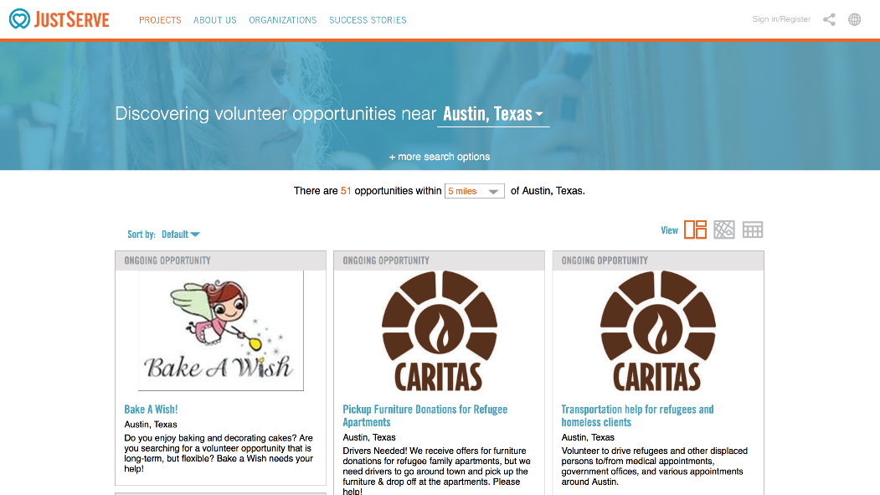
How Do I Volunteer?
1. Visit JustServe.org
2. Enter city, state, or zip
3. Apply advanced search filters if desired
4. Choose your desired project
5. Select Volunteer

Slide 8
Why we serve in the community
Who can SEARCH for Projects or Opportunities?
….anyone
Who can SEND in Projects or Opportunities?
…..any organization, group, person
Who can POST Projects or Opportunities ?
…..any organization, group, person approved and follows guidelines
Either Sign up and submit project/opportunities
OR contact our Local Just Serve Specialist
Heather Froisland - hfroisland@justserve.org
(Backup) Kurtis Willden - wombazzie007@gmail.com
Notes:
Attention activity: Share the quotes above.
Invite participants to share how giving service in faith, nonprofit, community, or governmental organizations has benefited them.

